Slide 1
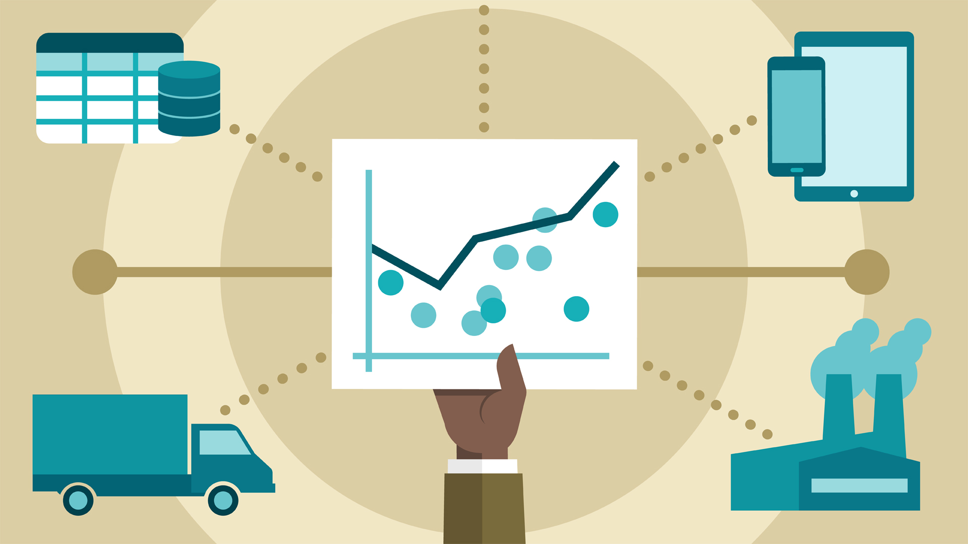
Analytics usecases in Manufacturing
By : Ankit Malviya

Slide 2
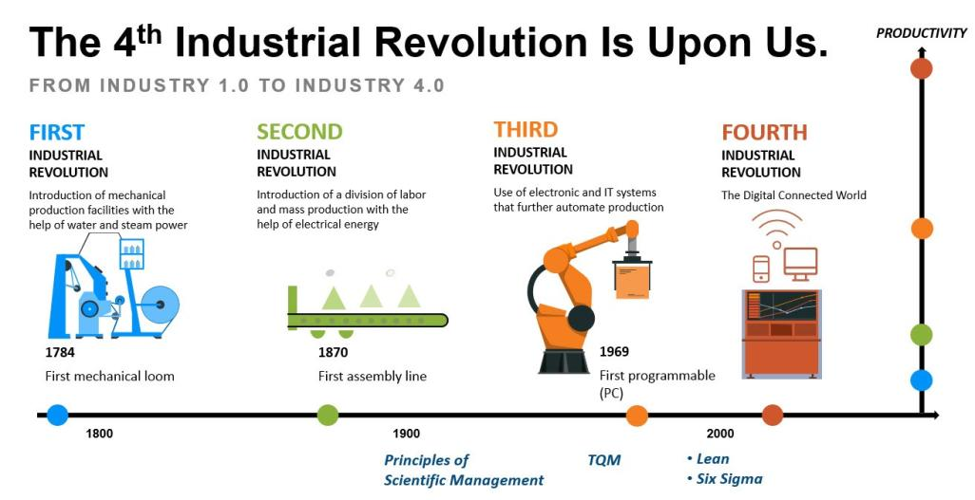
Notes:
https://www.salesforce.com/blog/2018/12/what-is-the-fourth-industrial-revolution-4IR.html

Slide 3

Artificial Intelligence is undeniably an essential part of Manufacturing Industry 4.0
AI is not just bound to have effective implementation in the production floor. In fact, these AI algorithms can be successfully incorporated to maximize the supply chains, customer analytics, logistics etc to flawlessly implement the market changes in the organization.
AI algorithms improve the overall process efficiency by helping the manufacturing AI to detect location patterns, weather aspects, customer behavior, economic and political factors and much more.

Slide 4
Common Analytics Use cases for Manufacturing Industry
Predictive & Preventive Maintenance
Demand forecasting & Inventory Optimization
Computer Vision in Manufacturing
Manufacturing Chat bot
Warranty analysis
Lean Manufacturing with AI
Tracking Manufacturing Overhead
Testing and Simulation of new Manufacturing Processes
Pricing Optimization in Manufacturing
Build to order configurations in Manufacturing
Customer analytics in Manufacturing
Text Analysis in Manufacturing
Logistics in Manufacturing

Slide 5

Predictive & Preventive Maintenance
Predictive & Preventive Maintenance is the way to forecast the moment when the equipment fails to perform the task and to prevent these failures from happening or at least to reduce their frequency.
With the help of Machine Learning techniques it is possible to
Determine the operational status of equipment.
Evaluate present condition of equipment.
Detect anomalous conditions in a timely manner.
Estimate the remaining useful life of an asset.
Predict whether an asset may fail in the near future.
Even main causes of failure of an asset is identifiable.
Predictive & Preventive Maintenance is helpful in identifying, what maintenance actions needs to be taken, by when and on which asset

Slide 6

Benefits of Predictive & Preventive Maintenance
Significant reduction in unplanned machine downtime.
Minimization of production losses.
Creates an ideal user experience while drastically reducing maintenance and warranty costs for the manufacturer.
The manufacturer may plan a break or a shut down for repairing, to avoid considerable delays and failure, caused by more significant problems that may arise.
Sensor data analysis can detect manufacturing defects early, which reduces the time and cost related to adjusting the production processes.

Slide 7
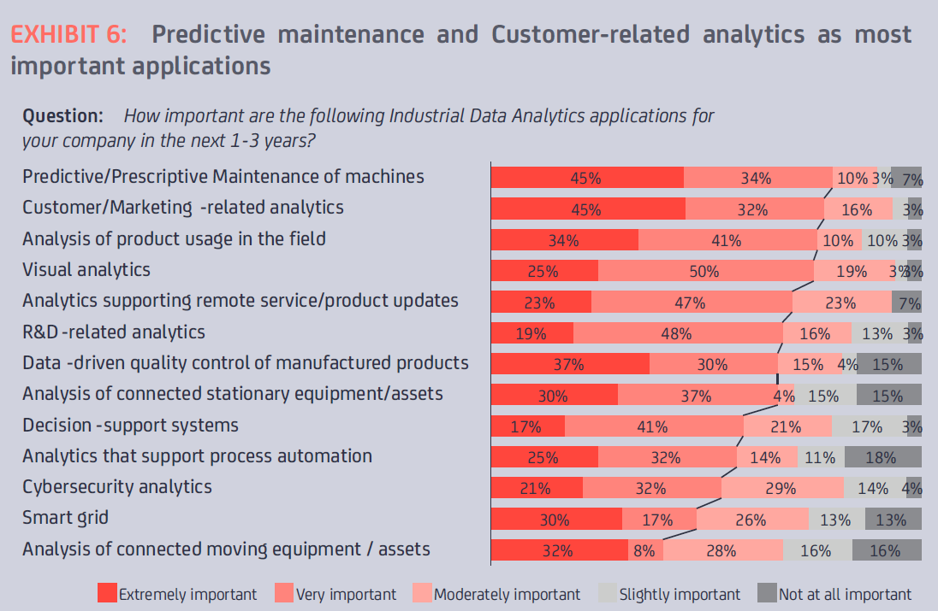

Slide 8
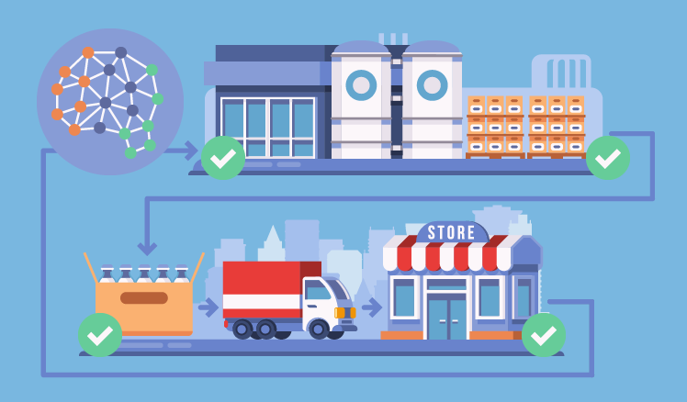
Demand forecasting & Inventory Optimization
Good inventory management revolves around a single contradiction:
Keeping enough stock in the warehouse to ensure the business keeps moving but not enough stock to drain its limited cash reserves.

Slide 9

Demand forecasting & Inventory Optimization
Demand forecasting and inventory management takes into account numerous factors, among which are external factors like the economy or markets, raw material availability, etc. to get a more complex view of manufacturing business performance and further planning.
With the help of analytics, the companies can predict potential delays and calculate probabilities of the problematic issues.
The companies can use analytics to identify backup suppliers and develop contingency plans.
Time series prediction model can estimate, what demands will arise in the coming days across all items in your inventory.
The online inventory management software helps to collect data that may be of great use for further analysis.
Reinforcement Learning systems for full-inventory management is the more advanced artificial intelligence approach that involves a model taking serious control of the inventory operations, with human checks and balances.

Slide 10
Benefits of Demand forecasting & Inventory Optimization
It improves the supplier-manufacturer relationship, as both can efficiently regulate their stocks and supply process.
It gives the opportunity to control inventory better and reduce the need to store significant amount of useless products.
All the data coming from the production line, therefore, creates continuous opportunities for optimization, cost saving, and prevention, as long as the right tools are available for data analysis.

Slide 11
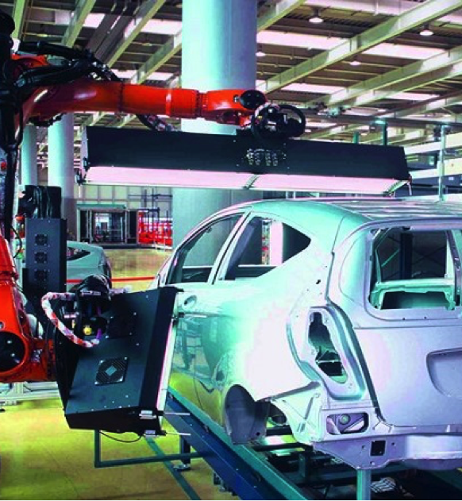
Computer Vision in Manufacturing
AI-powered technologies and computer vision applications found their usage in manufacturing at the stage of quality control.
In this respect object identification and object detection and classification, proved to be very efficient.
Usually, quality control monitoring was performed by people. However, now it is more common to rely on computer vision rather than on human vision.
These monitoring systems usually consist of computer hardware and software, cameras, and lighting for image capturing. After that, these images are algorithmically compared to the standards to identify discrepancies.

Slide 12
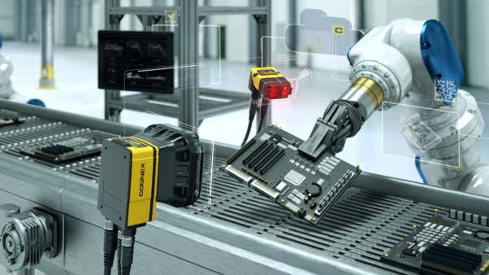
Benefits of Computer Vision in Manufacturing
Improved high-quality control
Decrease in labor cost
High-speed processing capability
Continuous operability 24/7.

Slide 13
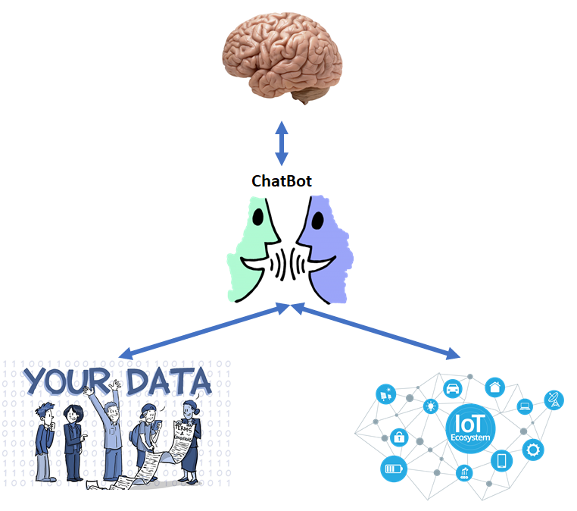
Manufacturing Chat bot
Manufacturing is a complex sector and involves meticulous coordination among various departments and processes. Employees often face a tough time to get a high amount of data manually from a diverse set of functions such as accounting, HR, sales, supply chain etc. Chatbot helps in gathering the data.
Manufacturing bot makes use of Artificial Intelligence that helps manufacturer to decide upon intelligent manufacturing methods and practice.
It automates daily manufacturing tasks using chatbots to get improved ROI on manufacturing efforts.
It provides the required information on any mobile device and optimize your supply chain.

Slide 14

In following ways Manufacturing Chat-bot is helpful
Integration with Internal Databases
For crucial accurate information handy all the time, manufacturing bots can be integrated with ERP and CRM
Efficient Supply Chain
For improving manufacturing, inventory and shipping management, chat bots lets the employees from different departments and multiple parties to communicate with one another in different time zones.
Role-specific Support
To make decision-making faster and more precise, bots provide customized support across various roles within the organization.
Quality Assurance
Chat-bot can be instrumental in quality control by identifying factors responsible for the product and process failure and help the manufacturers in fixing them.
Easy Data On-the-go
It can be accessed through mobile devices.
Streamlined Process
Chatbot makes the manufacturing process more streamlined and leaner.
It synchronizes between roles, departments and functions.

Slide 15

Benefits of Manufacturing Chat bot
All-device Support
Manufacturing bot can share the required information with your employees on all devices with a messaging application. It does not require a separate application.
Improved ROI
With automated quality control, bots can minimize error possibilities and reduce consumed time. This will bring down the manufacturing cost and result in higher ROI for you.
System Integration
Manufacturing bot can be integrated in internal databases and can be deployed on the cloud or servers. This ensures workforce has all necessary details on their fingertip.
Reduced Man-Hours
By handling numerous monotonous and time-consuming tasks, the bots can minimize the human intervention and save significant man-hours which can be utilized in more productive tasks.

Slide 16
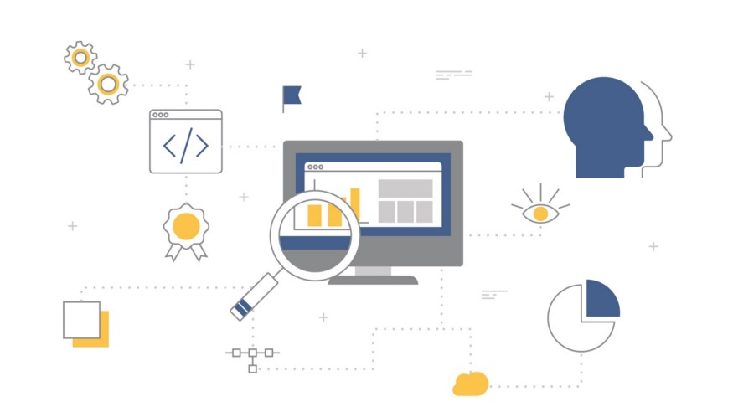
Warranty Analysis
The manufacturers spend a considerable amount of money every year on supporting warranty claims.
Warranty claims disclose valuable information on the quality and reliability of the product. They help to reveal early warnings or defects of the product.
Using this data, the manufacturer can make improvements to the existing products or develop new ones, more effective and efficient.
Modern warranty analytics solutions help manufacturers to process vast volumes of warranty-related data from various sources and to apply this knowledge to discover where the warranty issues are rising and the reasons for their occurrence.
Warranty Fraud situation today:
Industry studies demonstrated that10% of warranty costs are related to fraud-warranty claims, which cost manufacturers, billions of dollars.
Warranty Fraud Detection Solution leverages advanced and predictive analytic capabilities to find claims with a high probability of fraud or payment adjustment.

Slide 17

The three factors which explain the importance of Artificial Intelligence in Warranty Analysis
Reacting at the speed of business – The velocity of business is rapidly increasing and will continue to do so in the foreseeable future, it’s very important to have a quicker solution to detect fraud.
Efficiency –ML can often be more effective than humans at detecting subtle or non-intuitive patterns to help identify fraudulent transactions. Moreover, unsupervised ML models can continuously analyze and process new data and then autonomously update its models to reflect the latest trends.
Handling increasing volumes of information –Machine-Learning improves with more data because the ML model can pick out the differences and similarities between multiple behaviors.
With the help of smart analytics, it is possible to either avoid or to foresee warranty or recall issues, potentially saving significant amounts of money.

Slide 18

Lean Manufacturing with AI
Lean Manufacturing is one of the best examples of how manufacturing AI has excelled over time.
Waste is a strategic operational loss in manufacturing, but factories that harness industrial AI technologies as an integral part of their lean methodologies can continually improve their production processes to minimize waste.
With industrial AI, process engineers can predict and prevent production waste by identifying areas of loss and prescribing focused actions that reduce product defects and inefficiencies.
This is done by employing predictive analytics and Automated Root Cause Analysis to anticipate process failures that result in wastage.
Beyond anticipating when waste will exceed thresholds, by implementing predictive simulation, process engineers test production parameters until optimal values are determined for minimizing waste and rework.

Slide 19

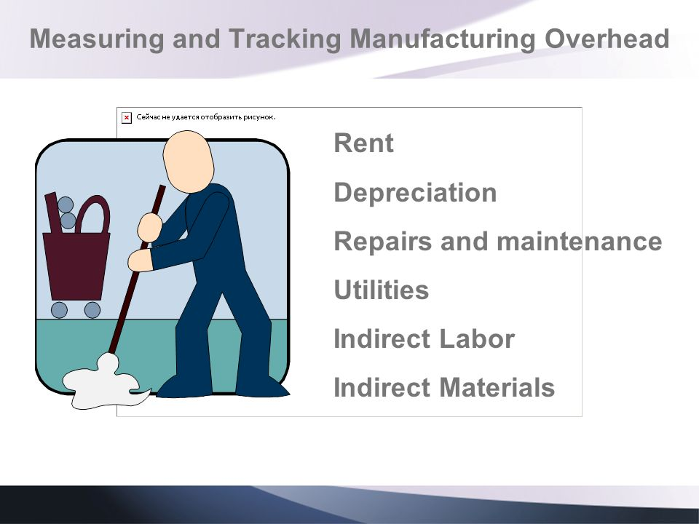
Tracking Manufacturing Overhead
The overhead costs are determining the profitability of each manufacturer.
Many small and midsized manufacturing companies, we have seen the emphasis they place on managing their costs. Because when margins are thin, optimizing costs becomes critical. Therefore, this is an area where AI can add great value.
Just as analytics such as cost modeling and cost forecasting can help in managing and monitoring direct costs, we can effectively use analytics to track manufacturing overhead costs.
Part standardization is one of the big areas that can hugely contribute to reduce supplier-related costs. It can reach a significant reduction in the part and supplier proliferation. This saves not only costs but time on managing parts data.
Labor cost tracking is another big area that can affect overheads. On an average 30-40% of overhead in manufacturing is formed by labor costs.
Therefore, it is critical to link not only job roles and wages to certain processes but individuals. Employee badges can be tracked with sensors placed on the shop floor. This way manufacturers can identify the exact cost of each task in a process, broken down to individuals.

Slide 20

Testing and simulation of new manufacturing processes
The day has come in manufacturing when no risk has to be taken when implementing a new product or process. Both manufacturing processes and the products can be tested before production/implementation.
Huge savings can be made when using predictive analytics in testing.
One single product might require thousands of different quality tests. The number of the tests required can be hugely reduced if pattern recognition and predictive analytics are used to determine the number and type of tests truly needed, instead of performing all tests on all items.
It is possible through digital twins, virtual reality environments and manufacturing process simulations. Using such environment and tools can allow manufacturers to eliminate the risk from decision-making processes.

Slide 21
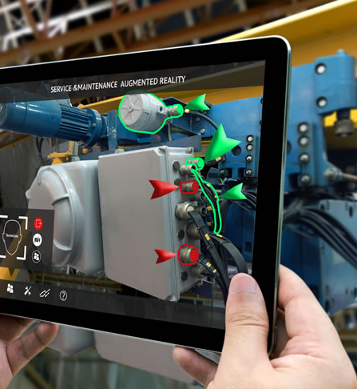
Benefits of Testing and Simulation of new manufacturing processes
Model-based simulation is usually an efficient technique to make difficult problems more tractable.
Efficient use of simulation can help in optimizing the entire production process, from design, to prototyping, and to manufacturing.
Simulation enables a cost-effective examination of “what if” scenarios, system interactions, and malleable topologies that traditional design processes would not have time to consider.

Slide 22

Pricing Optimization in Manufacturing
Manufacturing and selling the product involves taking into account numerous factors and criteria influencing the product price. All the elements starting with the initial price of the raw material and up to the distribution costs contribute to the final product price. And what happens when the customer finds this price too high or too low?
Price optimization is the process of finding the best possible price for both manufacturer and customer, not too high and not too low.
Modern price optimization solutions can increase your profit efficiently. These tools aggregate and analyze pricing and cost data both from the internal sources & from your competitors and derive optimized price variants.
Under conditions of highly-competitive market and changes in customers’ needs, price optimization becomes a must and grows into a continuous process.

Slide 23
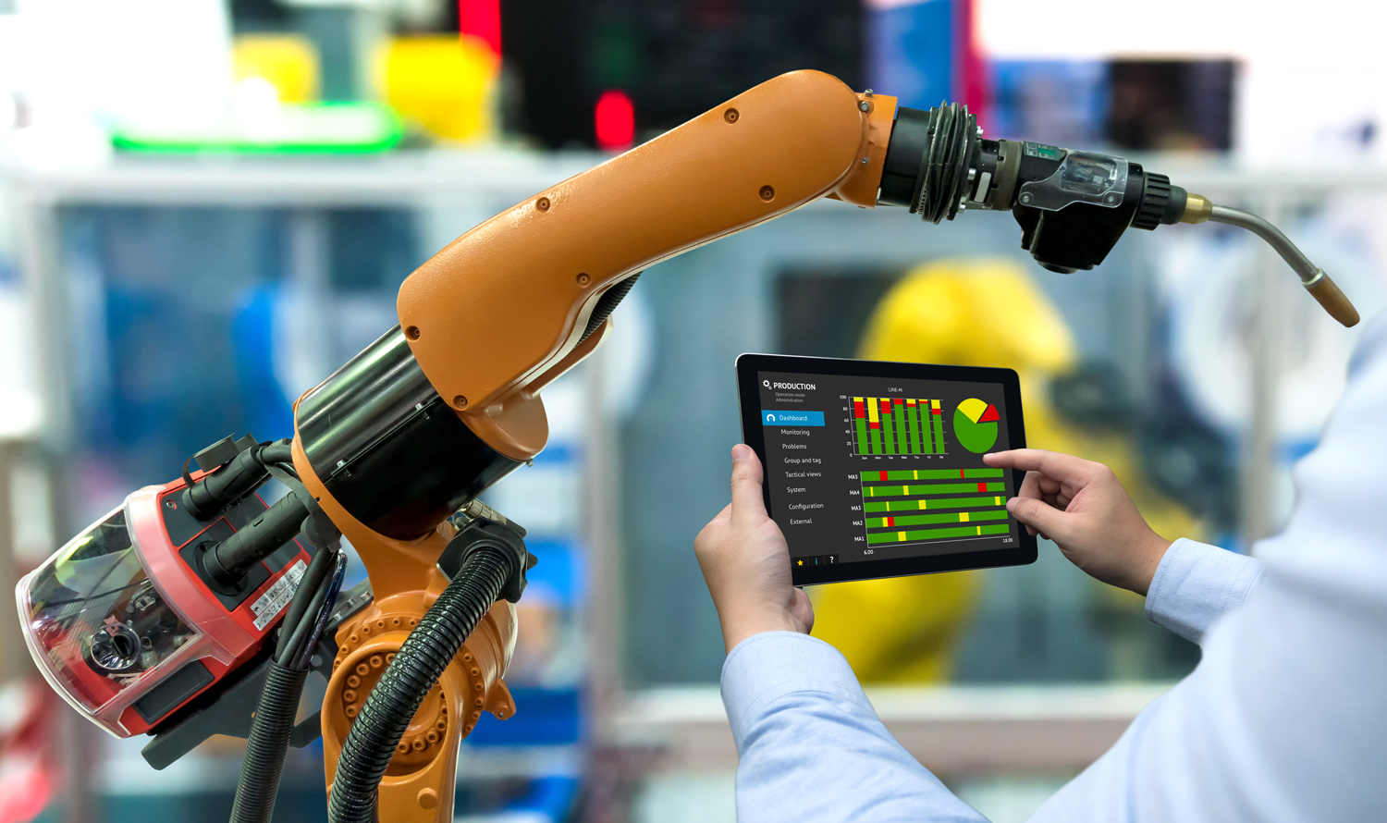
Build to order configurations in Manufacturing
Manufacturing ‘products to order’ became a trend and not just in the automotive industry but in aviation, computer services, and even consumer goods.
The build to order (BTO) production approach is a very efficient and profitable business model. But in order to see real growth from it, a well-defined data platform needs to be in place to analyze customer behavior and sales data.
The manufacturer needs to have access to all sales data and be able to make precise predictive analytics to foresee order volumes on each possible configuration and adjust their supply chain accordingly.
Also, sales and production data analysis is needed to identify the profitability of each product configuration.
This way manufacturers can define their ideal product portfolio to reach their highest possible revenue at a given time.

Slide 24
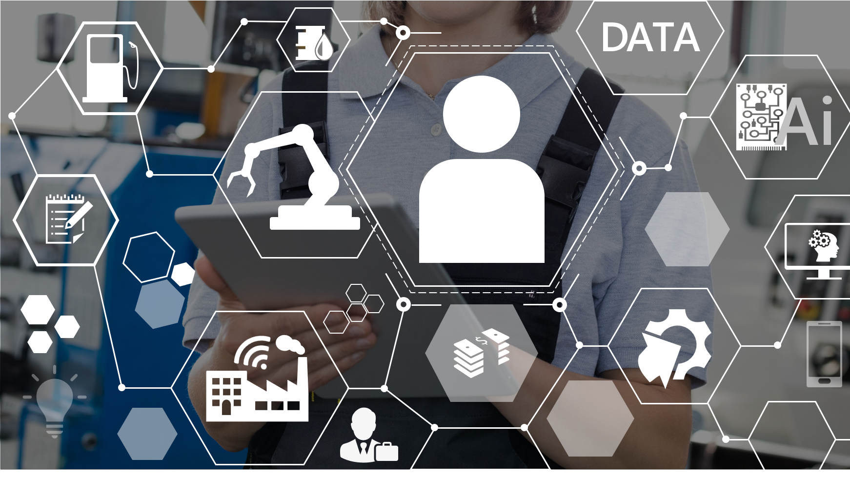
Customer analytics in Manufacturing
Manufacturers build, test, and tweak all manner of products, but perhaps the most important thing they forget is their relationship with customers.
By using Analytics, it became possible to quickly compare the performance of different sites and also to pinpoint the reasons for the differences.
In addition to internal production and sales data, it is also possible to analyze entire markets, build what-if scenarios and to use predictive models.
Access to these types of insights means that global growth strategy related questions can be answered based on factual data. Questions like where to open a new factory, which company site should be relocated/closed or whether to introduce a new product or not are easy to answer once the related data is collected and analyzed.
Using AI for product development, the manufacturers can design a product with increased customer value and minimize the risks connected to introduction of a new product to the market. Actionable insights are taken into account while modeling and planning. This data can strengthen the decision-making process.

Slide 25

Benefits of Customer analytics in Manufacturing
Aberdeen Group’s recent manufacturing research found that 43% of manufacturers cited finding new ways to serve customers as a primary area of focus for their business intelligence activities.
Aberdeen’s most recent analytics survey explored the performance of organizations with and without marketing analytics.
Organizations using marketing analytics achieved a 22% increase in the number of new pipeline accounts identified, a 38% greater improvement than companies without marketing analytics.
By applying analytical firepower to current and prospective customer data, marketing decision manufacturers can identify the best opportunities to pour into the funnel.

Slide 26

Text Analysis in Manufacturing
Most of the information available in the manufacturing industry is in unstructured, natural language format. The unstructured data could contain important and useful information that can inform decision makers across different phases of product lifecycle.
Manufacturer can get the latest and most relevant manufacturing & tech news all in one place in a summarized form and he can get insights on the latest regulations and legislation as it happens across the world
Text analytics can fetch automatic updates on mergers & acquisitions in manufacturing industry as well as potential targets.

Slide 27

Logistics in Manufacturing
In logistics, the usage of Analytics is extensive than in other manufacturing areas. Warehousing and transportation are both areas where AI can be used with great ROI
Intelligent Robotic Sorting is the effective high-speed sorting of letters, parcels, and even palletized shipments – one of the most critical activities of modern parcel and express operators.
Vehicle Telematics Can Streamline the Supply Chain.
Intelligent Route Optimization is critical for logistics operators to efficiently transport, pick up, and deliver shipments. Analytical infrastructures allow them to track freights and weather and road conditions in real time. With that, trucks can be diverted any time on their way when a faster and/or more cost-effective route is possible due to any changes. Natural catastrophes and other unpredictable events can be avoided saving millions of dollars a year for some of the biggest transporters.
Autonomous guided vehicles (AGVs) are already starting to play a bigger role in logistics operations.

Slide 28

Conclusion
We conclude by saying that Artificial Intelligence is going to revolutionize the manufacturing sector. Starting from designing and applications in production floor to management and supply chains & logistics.
AI is the ultimate source of unbounded innovations and augmentation in the manufacturing industry.

Slide 29

Thanks!

Slide 30
References
https://www.forbes.com/sites/louiscolumbus/2018/03/11/10-ways-machine-learning-is-revolutionizing-manufacturing-in-2018/
https://pdfs.semanticscholar.org/5208/fb1993935581ad7881df729ba253014854a2.pdf
https://www.researchgate.net/publication/227470655_Theory_of_inventory_management_based_on_demand_forecasting
https://www.logistics.dhl/content/dam/dhl/global/core/documents/pdf/glo-artificial-intelligence-in-logistics-trend-report.pdf
https://www.sas.com/content/dam/SAS/en_us/doc/analystreport/aberdeen-marketing-analytics-for-manufacturing-106822.pdf
https://digital.library.txstate.edu/handle/10877/7448
https://towardsdatascience.com/quality-inspection-in-manufacturing-using-deep-learning-based-computer-vision-daa3f8f74f45
https://azure.microsoft.com/en-in/industries/discrete-manufacturing/
https://www.salesforce.com/hub/service/how-ai-changed-customer-service/
https://www.techmahindra.com/warranteaze.html
https://www.machinemetrics.com/blog/lean-manufacturing-techniques-in-the-age-of-industrial-ai-seebo-blog
https://www.processingmagazine.com/ai-real-time-manufacturing-management/

